Slide 1

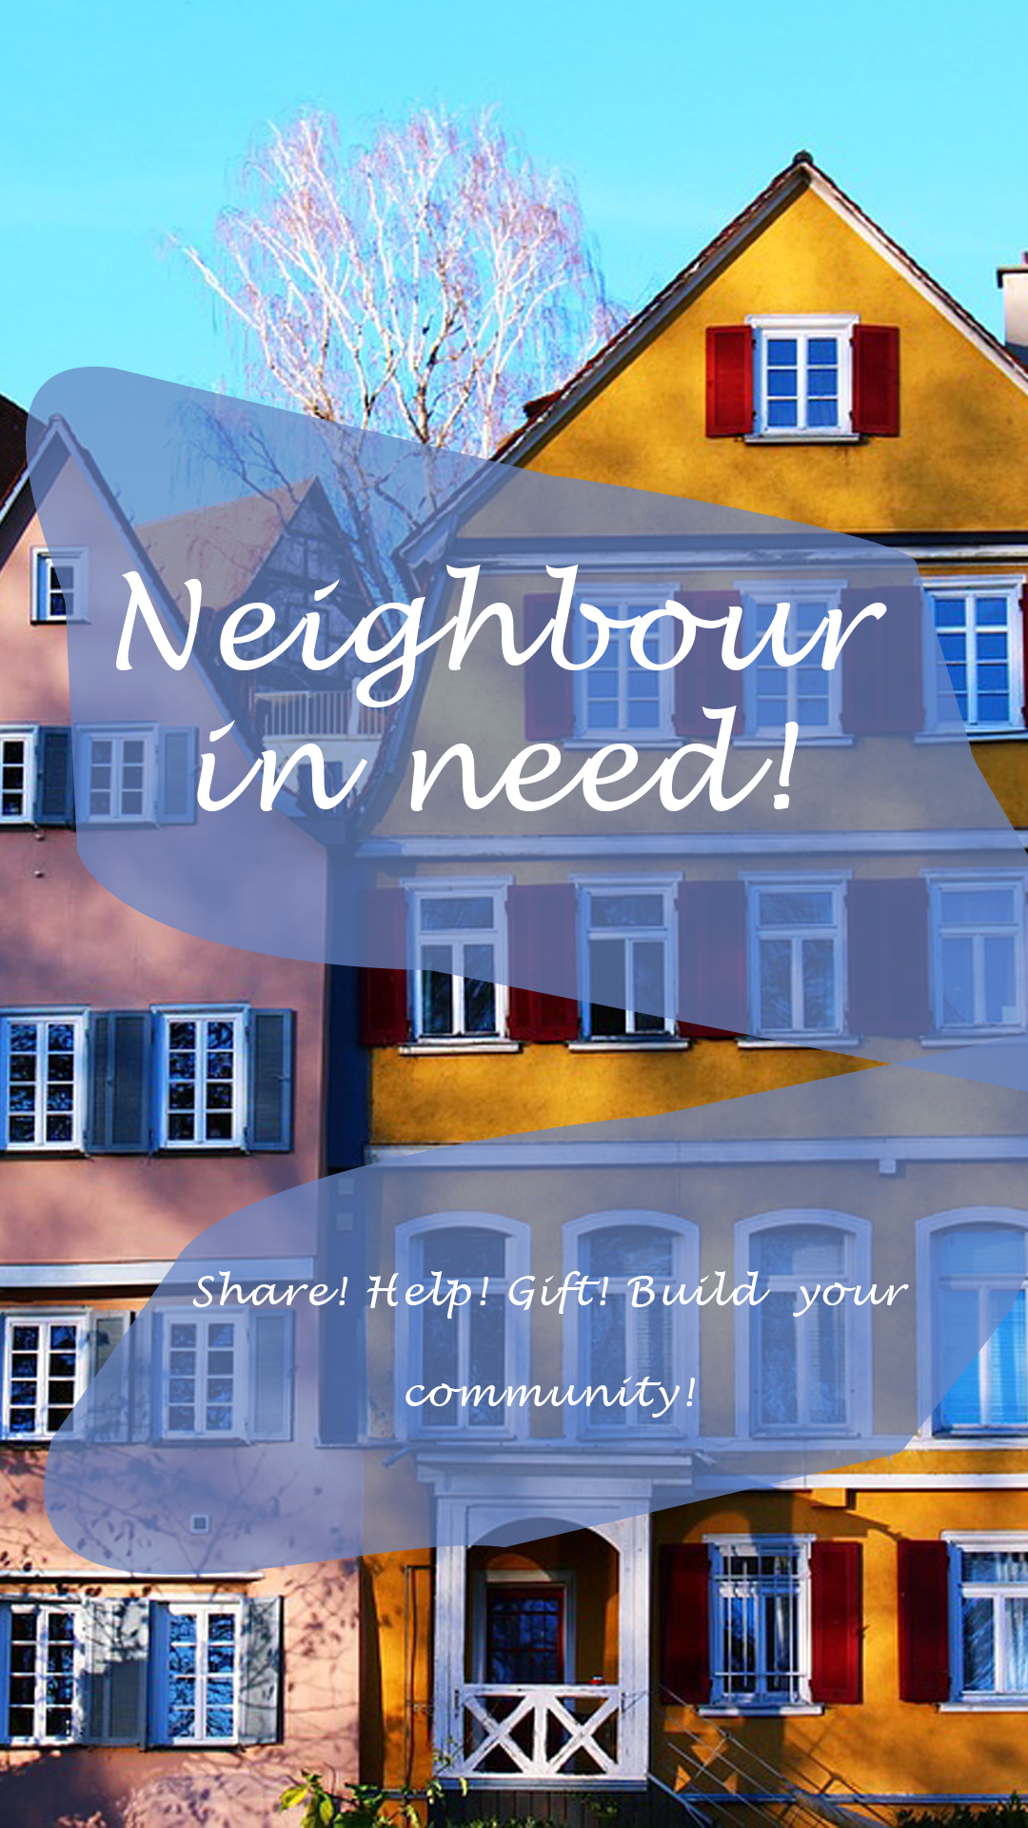
Mobile Computing
SS 2020 Neighbour in Need Fanni Marosi, 764345 Ebru Özcelik, 764249

Slide 2
Agenda
Vision
Personas
Functional Requirements
Non-Functional Requirements
Mock-Ups

Slide 3
Vision
Personas
Functional Requirements
Non-Functional
Requirements
Mock-Ups
For communality, for the neighbourhood
To help/share/gift and build a community
Users can:
Register
Create and search for advertisements
Gift something
Borrow/lend sth.
Offer help (e.g. going to the supermarket)

Slide 4
Vision
Personas
Functional Requirements
Non-Functional
Requirements
Mock-Ups
Our user group is very heterogeneous concerning:
Age
Gender
Job
Everybody (except children) could use the application

Slide 5
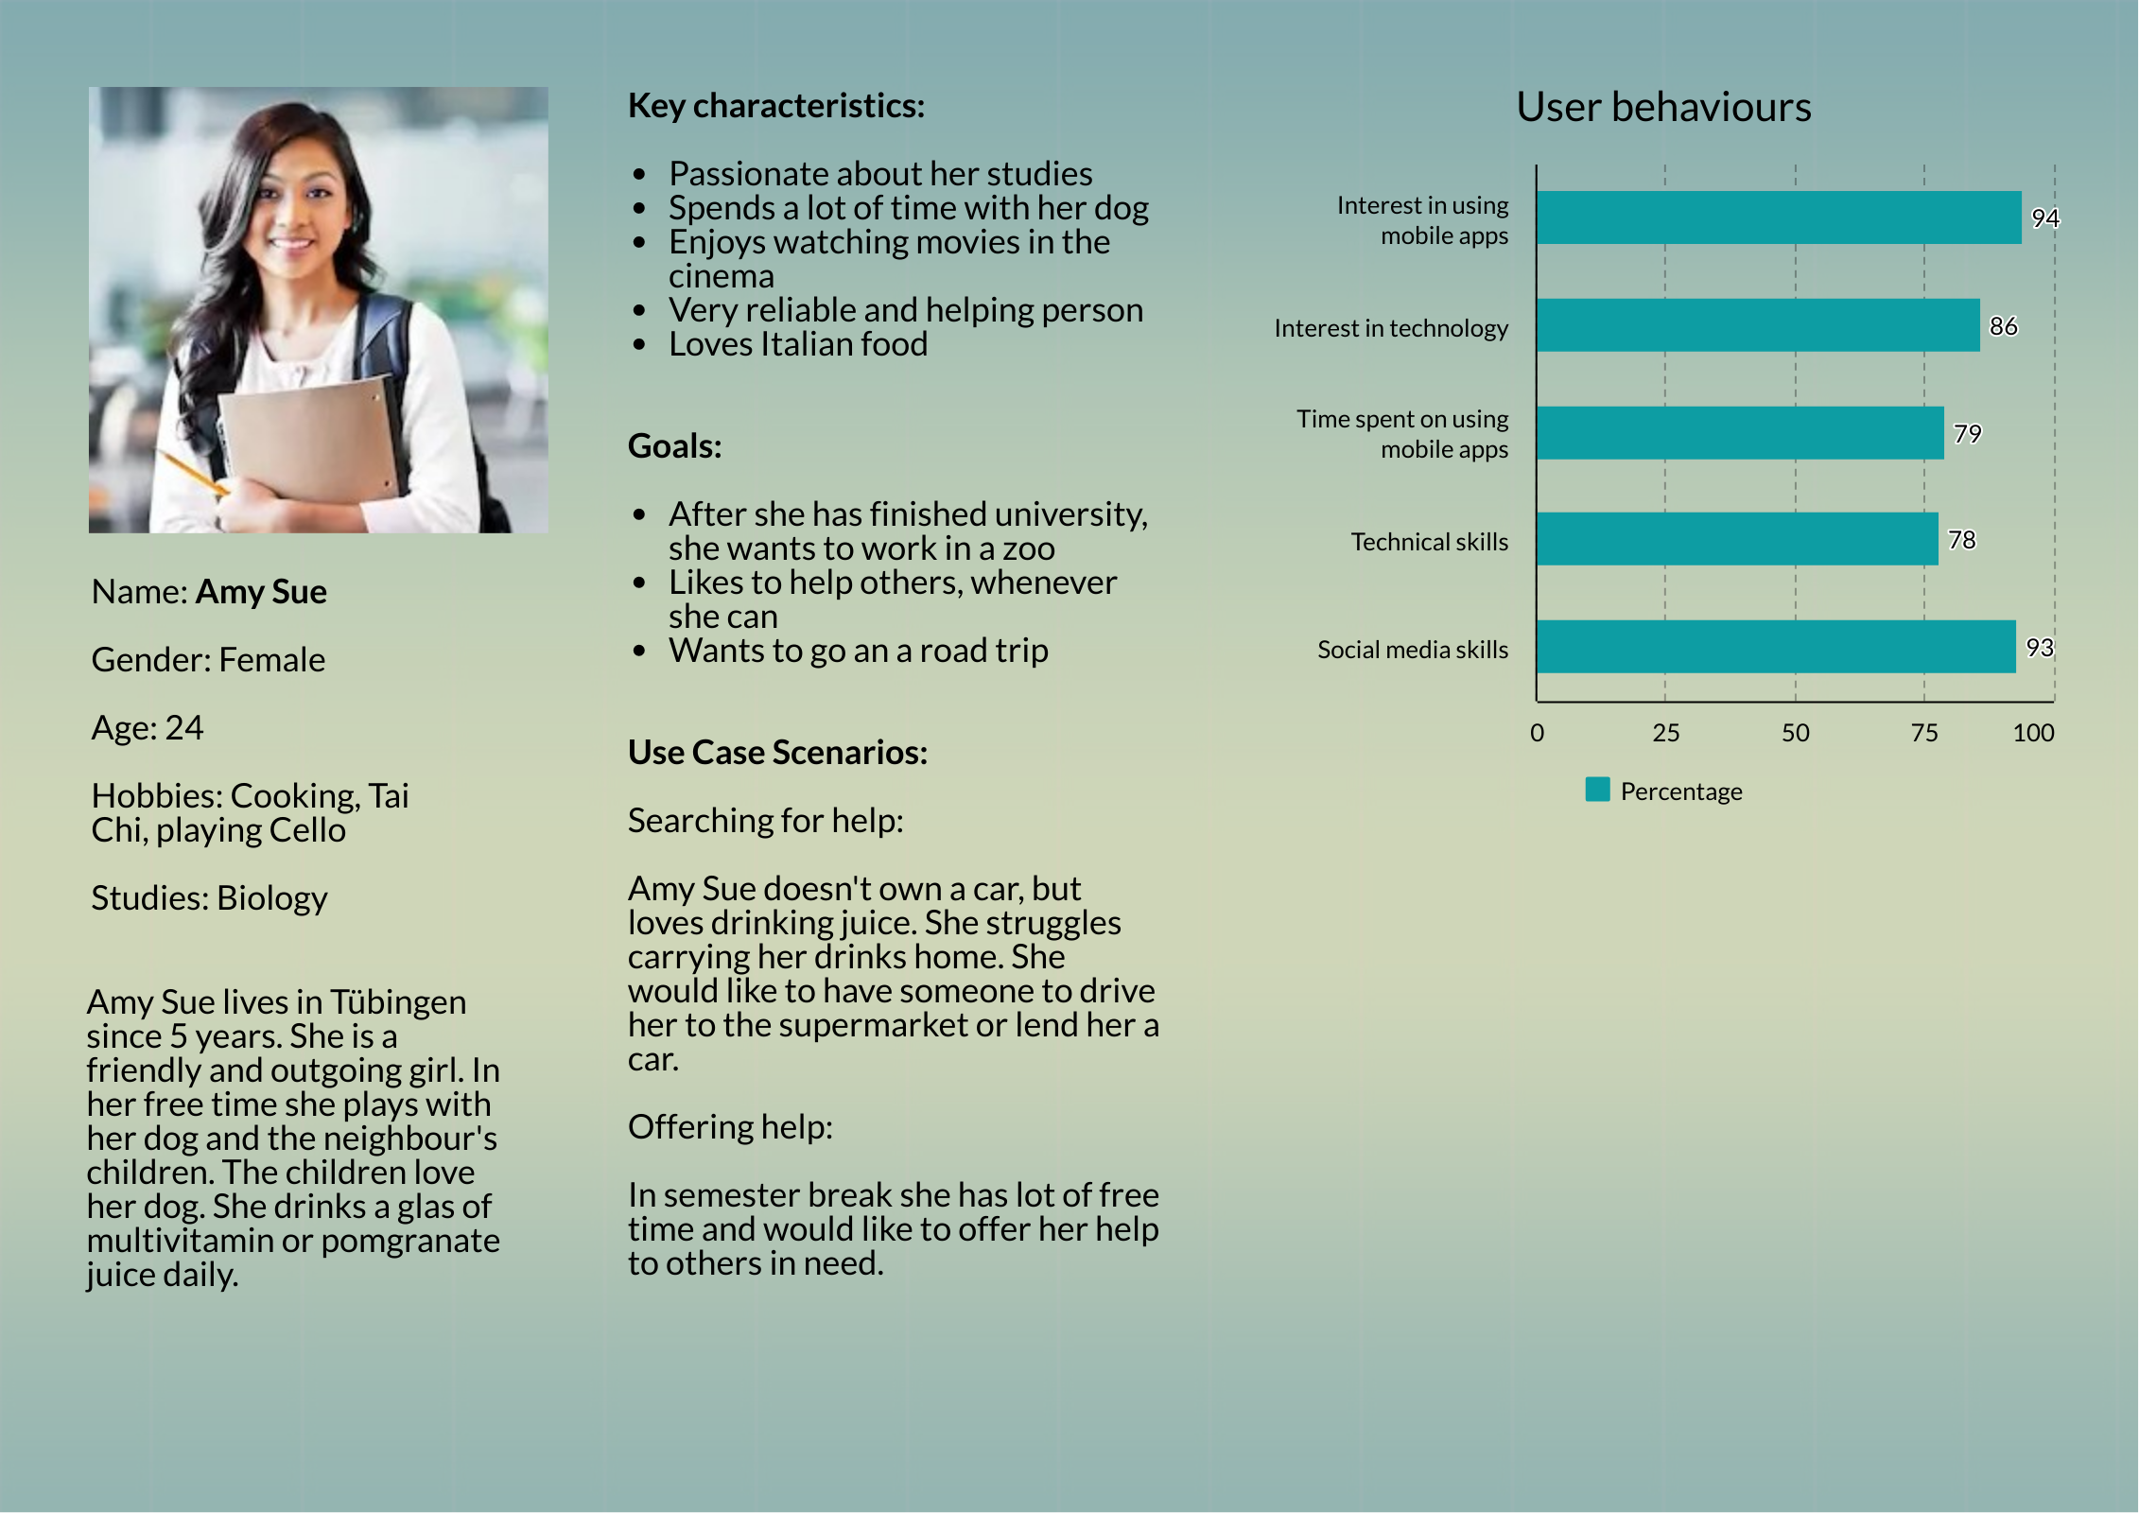

Slide 6
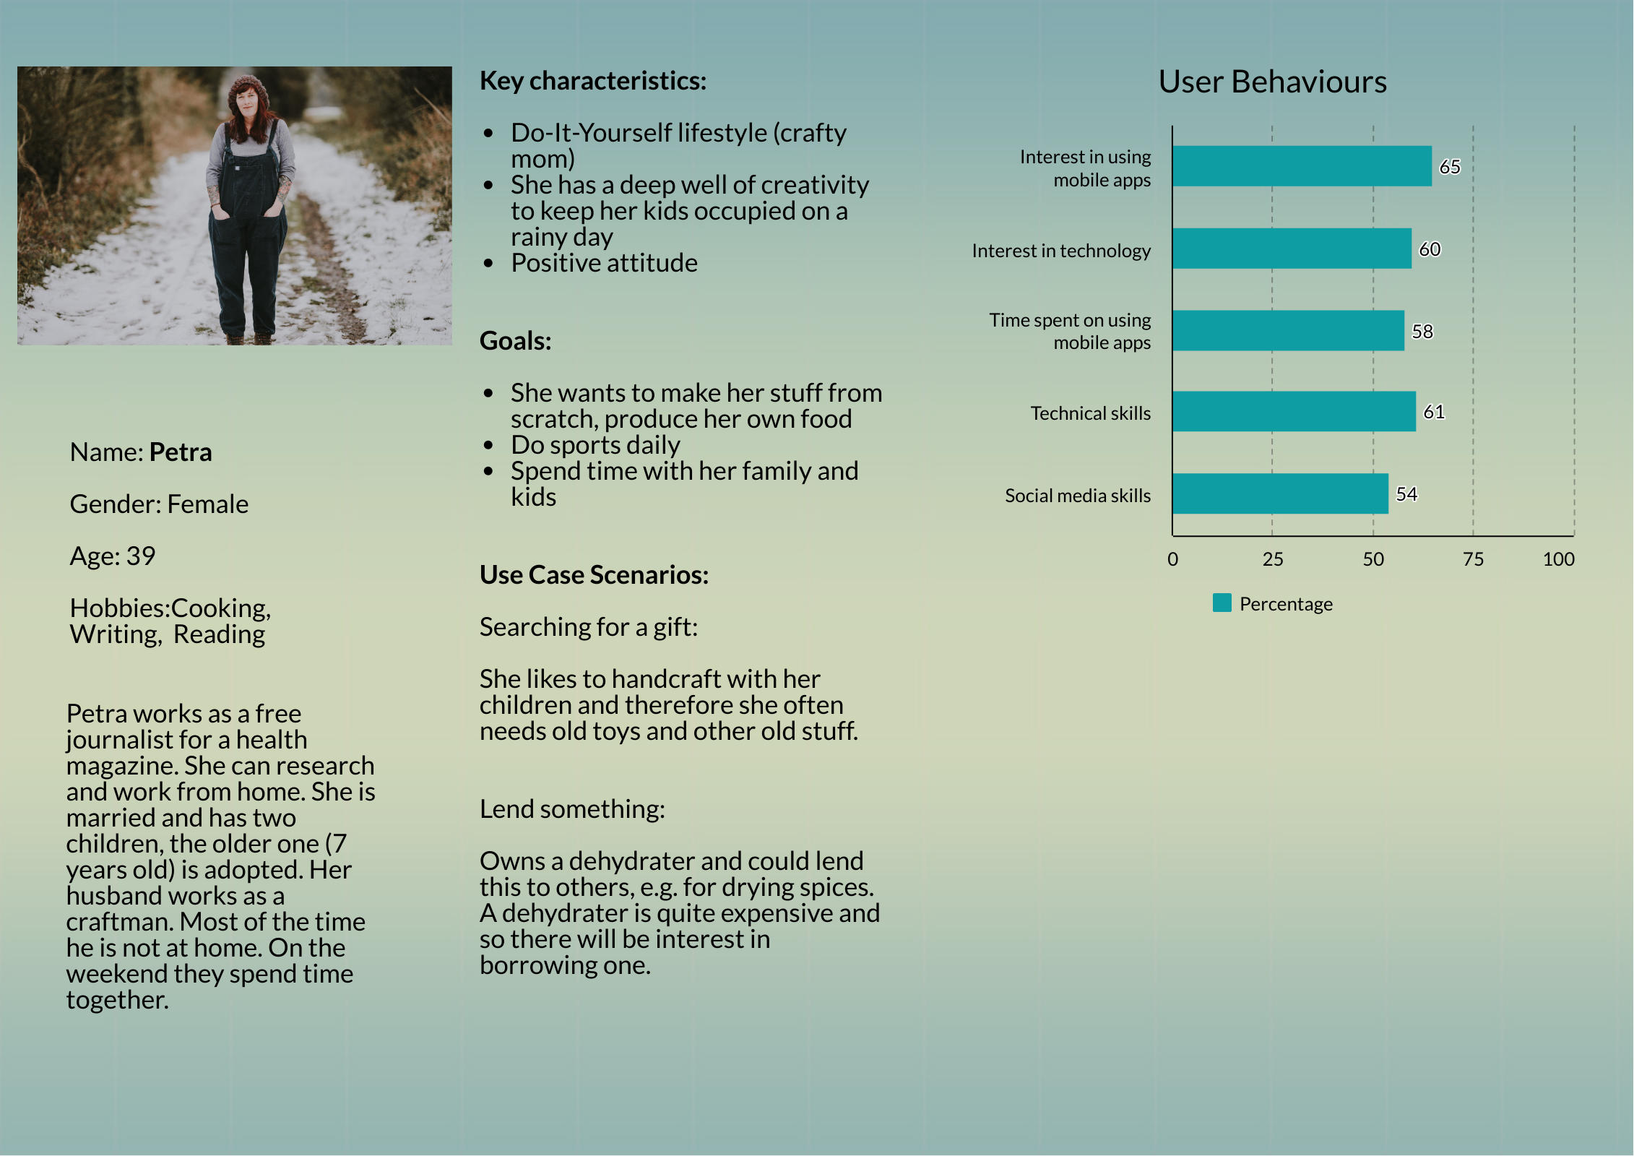

Slide 7
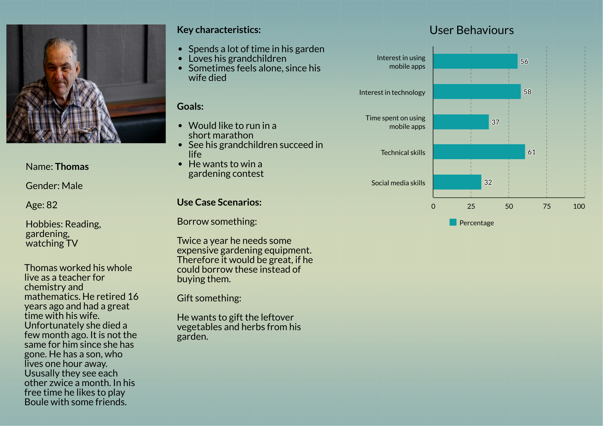

Slide 8
Vision
Personas
Functional Requirements
Non-Functional
Requirements
Mock-Ups

Slide 9
Functional Requirement | Level of importance
Create an account | 5
Login | 5
Create an advertisement | 5
Search for an advertisement | 5
Pick one advertisement from the list of results | 4
Request personal information | 4
Account management/settings | 3
Edit personal information | 3
Advertisement management „Offer“ | 3
Advertisement management „Borrow“ | 3
Rate other users | 2
Sort result list | 1
1 = not that important 2 = nice to have 3 = quite important 4 = important 5 = main or basic functionality

Slide 10
Vision
Personas
Functional Requirements
Non-Functional
Requirements
Mock-Ups

Slide 11
Non-functional Requirement | Description
Performance | Not longer than 3 seconds to load a screen, reduce network usage and computing to save battery-life
Portability | Should run on different Android systems
Screen Adaption | App should scale according the target’s screen size
Use-ability | Self-explanatory symbols, interaction easy to adapt to, used colours are limited to an amount of four
Security | Encrypt data and only ask for information, which is necessarily needed, constraint the input fields, user must pass the correct data type and the correct format within the correct range to pass the login/register screen
Reliability | System should reliable to perform the function the user asked for, feedback to the user performing actions, e.g. if you request contact exchange from another user
Accessibility | Appropriate button size, so that everybody can easily use them avoid red and green together
Availability | Application should be downloadable in the Google Play Store, where users can easily access and install it

Slide 12
Vision
Personas
Functional Requirements
Non-Functional
Requirements
Mock-Ups

Slide 13
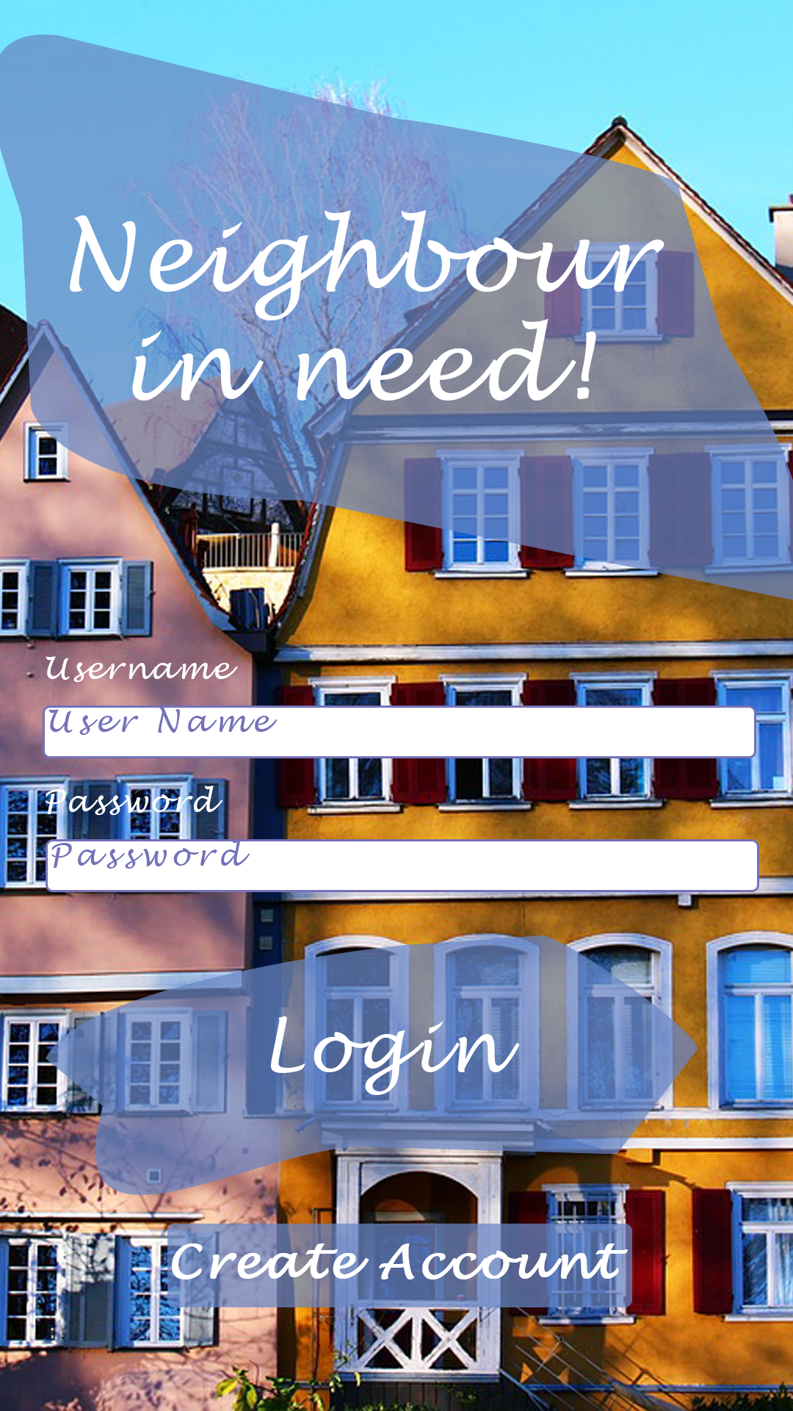
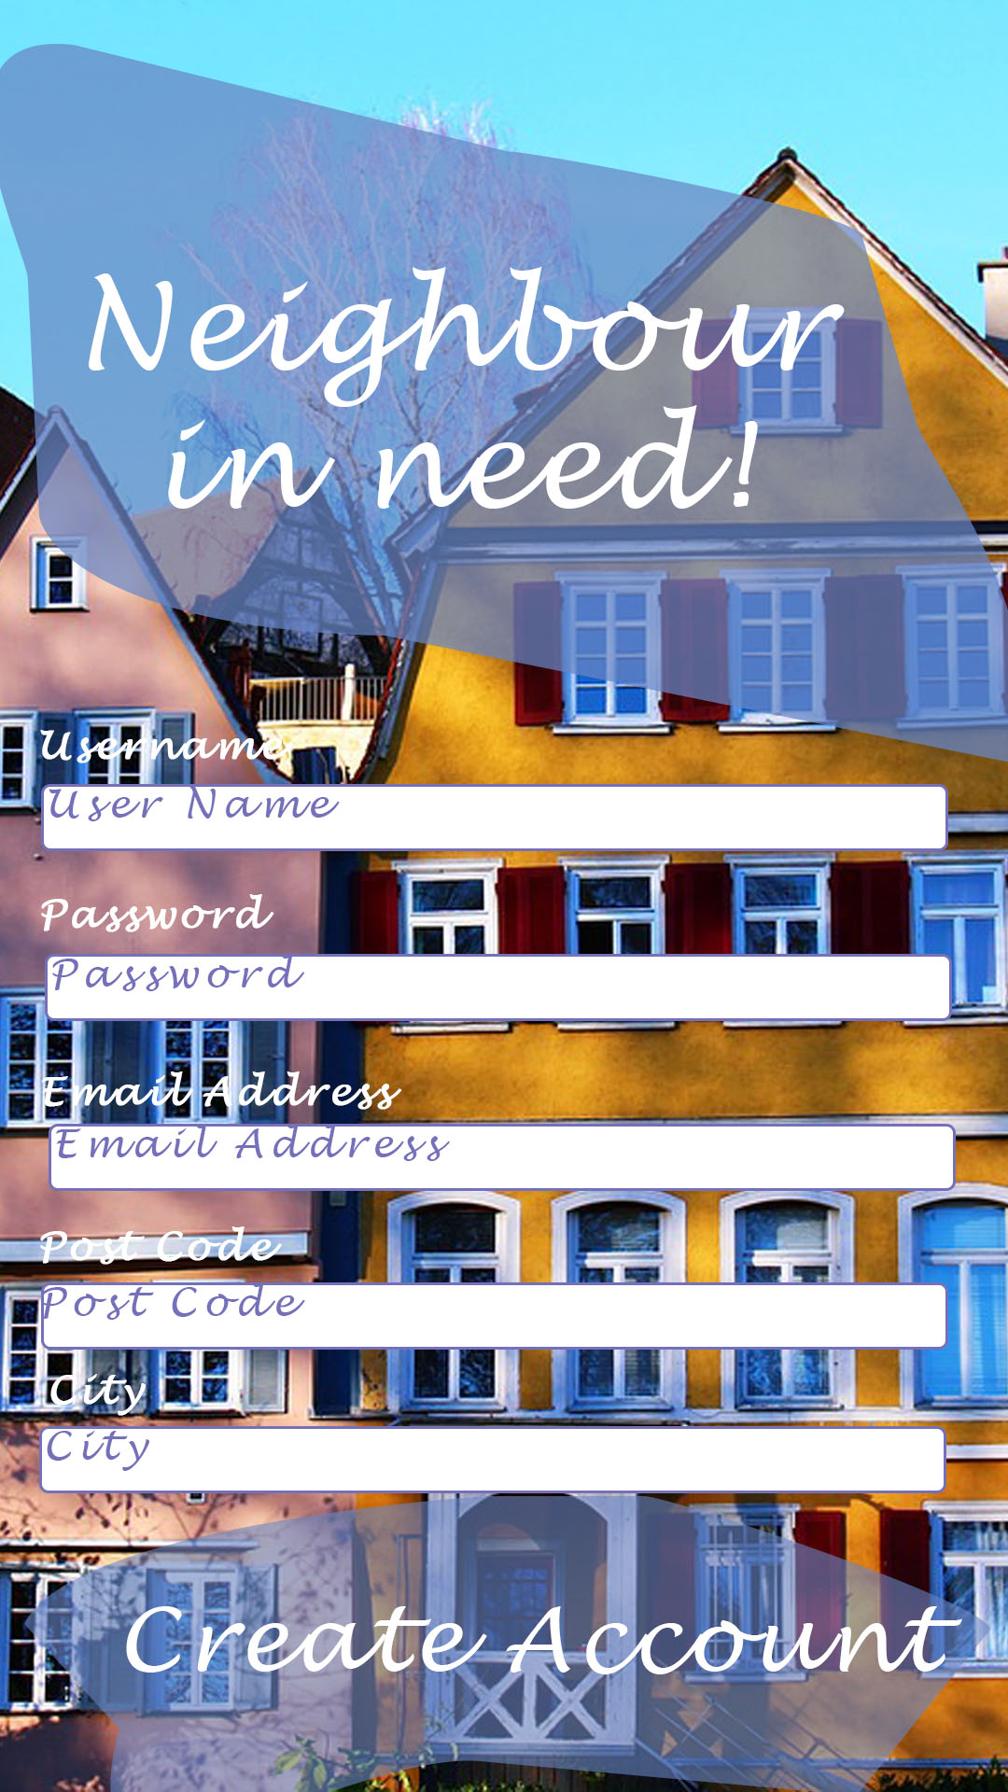

Slide 14
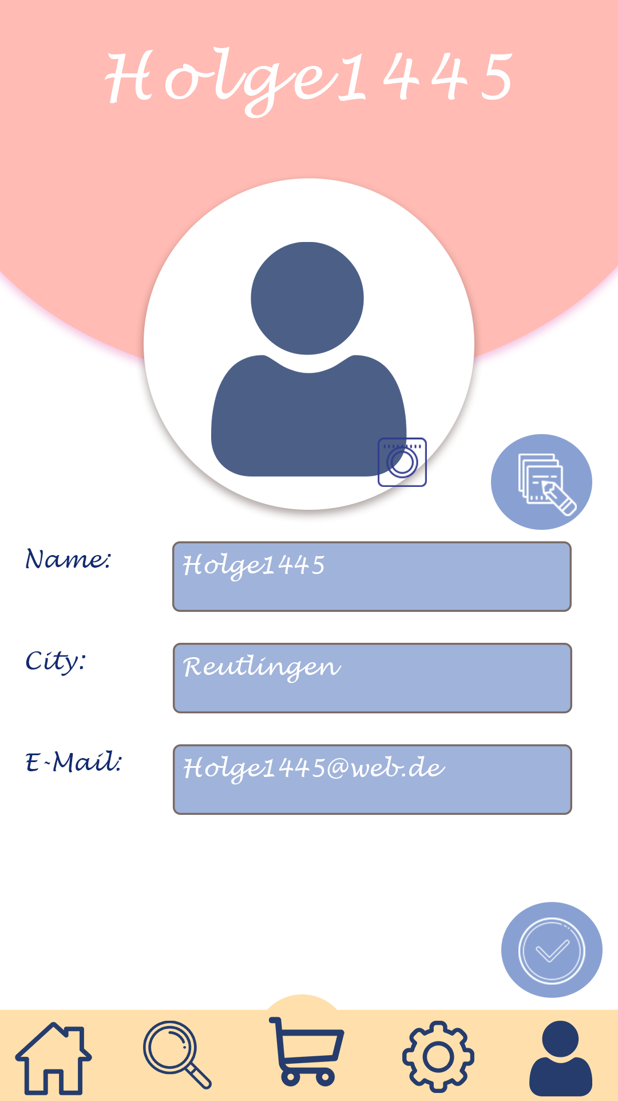
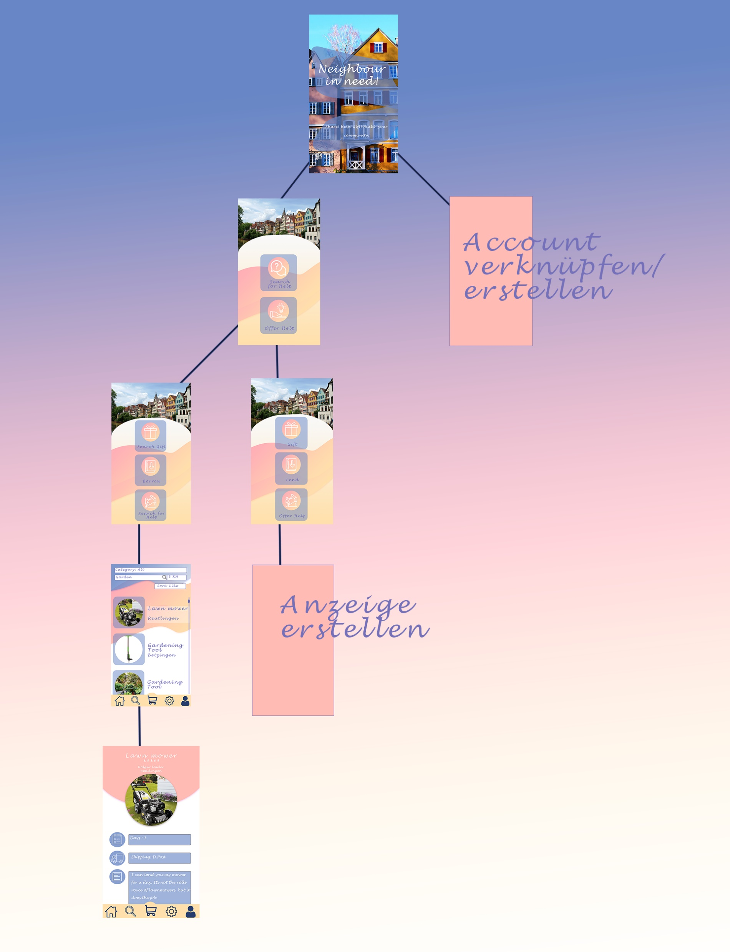

Slide 15
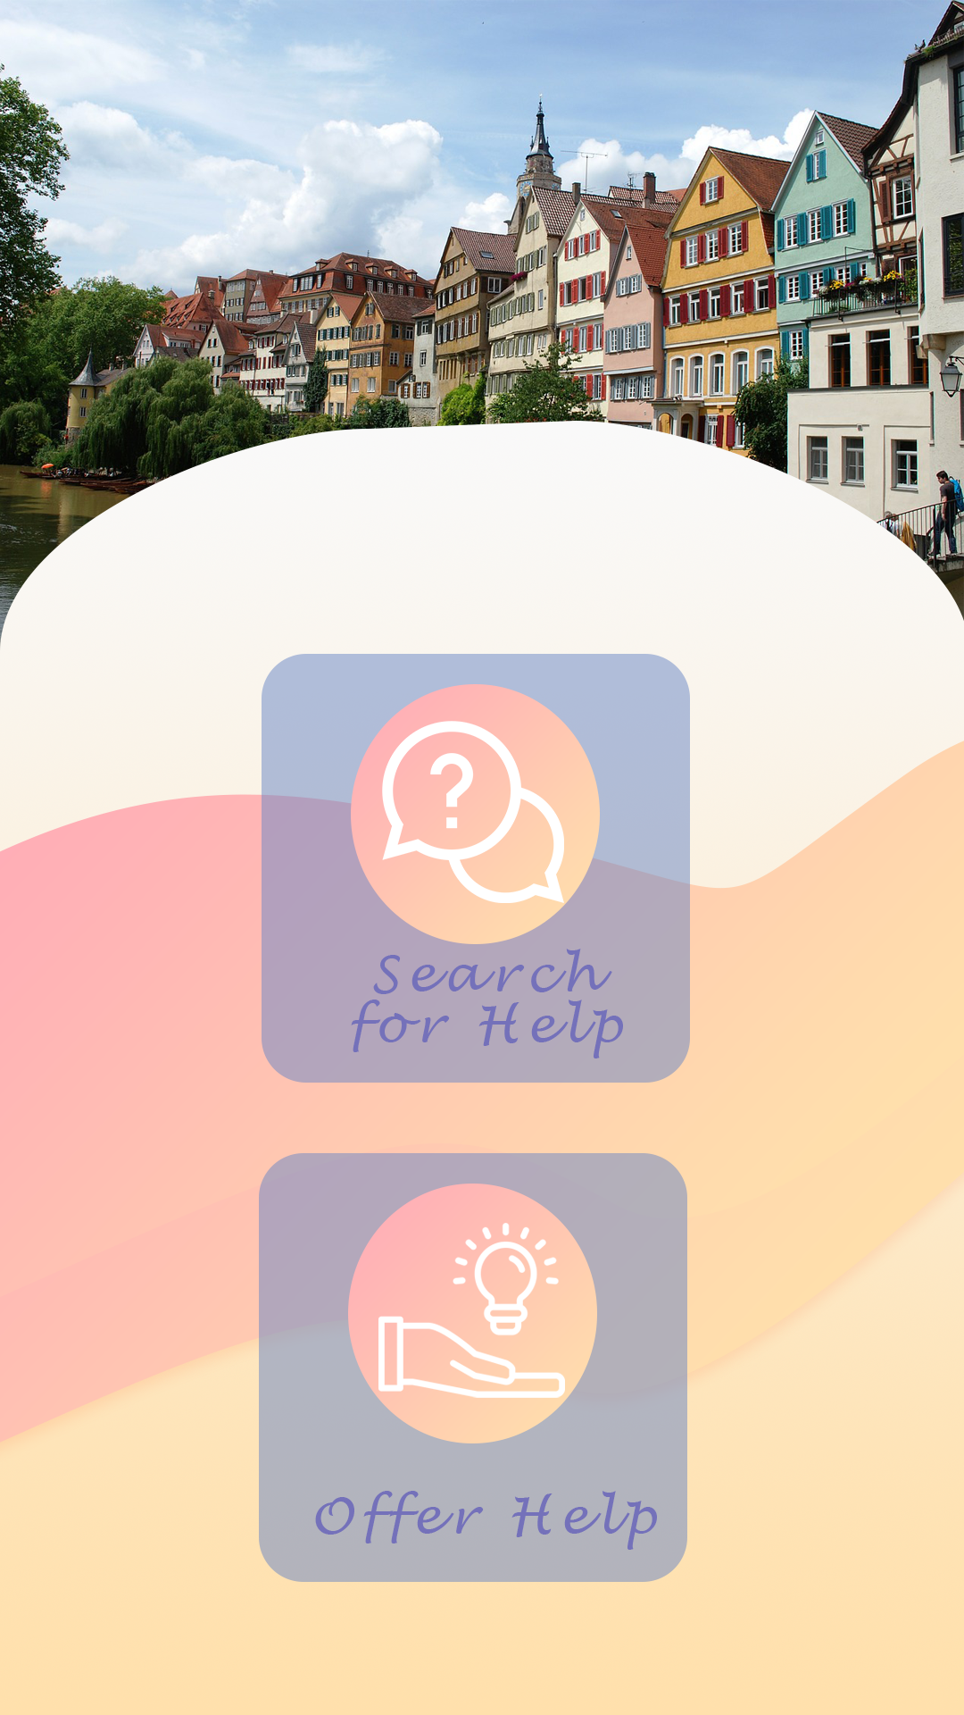
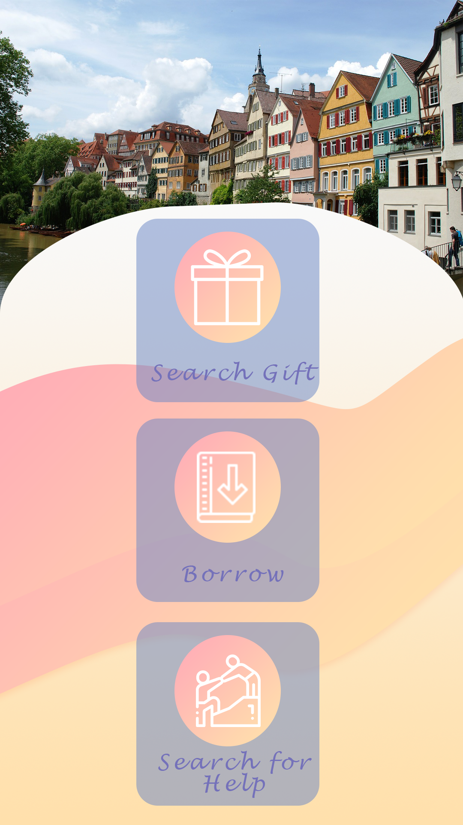


Slide 16
